Slide 1
Exploring Electronic Lab Notebooks (elns)
Kara McGaughey
Neuroscience Graduate Group (NGG)
Notes:
Hi everyone, my name is Kara McGaughey. I’m a fifth year PhD candidate in NGG
So just by show of hands, how many of you here have ever kept a traditional paper-based lab notebook?
Ok and now by show of hands, how many have found keeping a good paper lab notebook to be tedious?
Excellent. For my portion of this morning's session, we’ll be exploring an alternative to the paper-based lab notebook – an electronic lab notebook or ELN

Slide 2
AN OVERVIEW
What are ELNs?
Penn’s partnered ELN service: LabArchives
What are the advantages to using ELNs?
How do I use and integrate ELNs?

Slide 3
What are ELNs?
An ELN is a digital record of your research process and results.
Similarities with traditional lab notebooks:
Compile protocols
Document experiments
Store collected data
Gather references
Serve as an immutable record of your research
Unique and advantageous features of ELNs:
Enhanced accessibility
Enhanced searchability (e.g., searchable with keywords)
Secure and redundant
Easier, more flexible organization
Can track and review all changes
ELNs have many features of a traditional, paper-based lab notebook, with added benefits.
Notes:
First things first what exactly is an ELN?
An ELN, as the name implies, is a digital record of your research process and results
These ELNs have a host of functional similarities with traditional lab notebooks
Both can be used to compile procedures, document your experiments, store your collected data and collect references.
And, perhaps most importantly, they are immutable, unchangeable records of your research
In addition to the functional features of traditional lab notebooks, there are some key differences and advantages when considering ELNs.
For one, ELNs offer enhanced accessibility – you can access your notebook from any computer or phone anywhere you want
Easier searchability to find things quickly,
As well as security and redundancy to ensure that your data is safe
ELNs also offer additional and flexible ways to organize your information
And the ability track and review all changes that have been made
So, in short, ELNs possess almost all of the features of a traditional lab notebook, but with some added benefits.

Slide 4
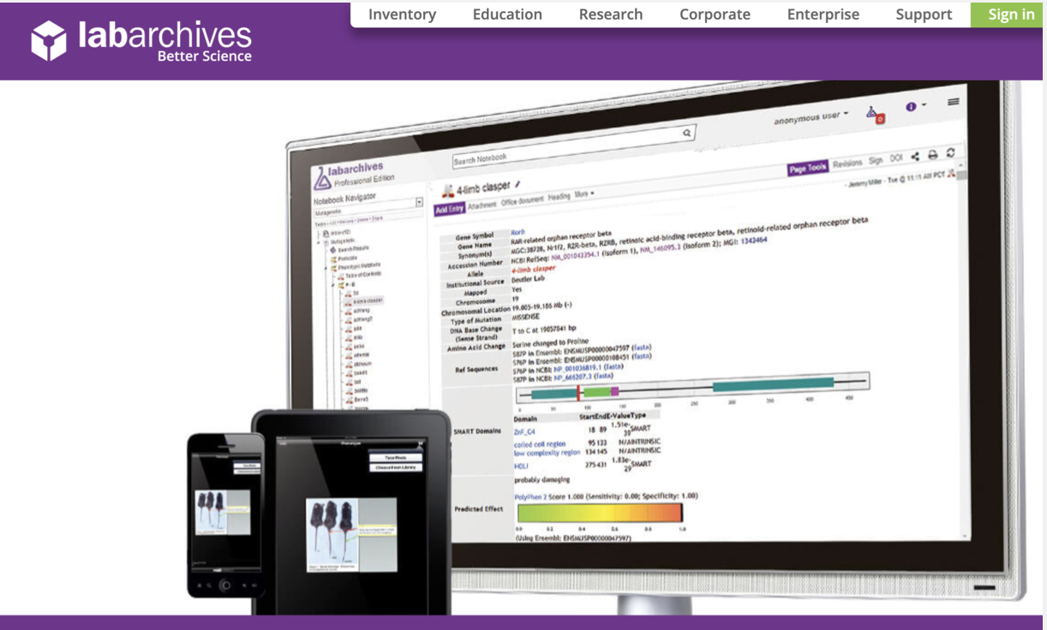
LabArchives – Penn’s partnered ELN provider
LabArchives
Common ELN features
Legal/security protection
Free for Penn students
Other options:
Evernote
OneNote
Google Drive/Box
You can use a combination of ELNs and other data storage tools to best suit your individual needs.
Notes:
And before I dive I in, I’d just like to point out that most of my experience and all of my examples today will involve LabArchives, which is the Penn partnered ELN
LabArchives has many useful features common to ELNs
They provide legal and security protection for all of your research data
And its completely free for Penn students
While LabArchives is certainly not the only ELN option available, other ELNs may come with additional costs and offer less support
Ans, it’s wroth stressing that you can use a combination of these ELN and ELN-like tools to best suit your individual needs. For example, I work with non-human primate electrophysiology data, and the files can get pretty large. So, while I store my experimental details and some preliminary analysis on LabArchives in my ELN, I use PennBox (which I sync to my computer) to store the files themselves.

Slide 5
ELNs are easily accessible
Cloud-based system allows you to access your ELN from wherever you are whenever you want.
LabArchives has apps for mobile devices and tablets and runs through the web browser for laptops/desktops.
Can also download files for easy offline viewing
Notes:
So, expanding on the unique and advantageous features of ELNs I briefly introduced, one of the biggest ones for me is accessibility.
Most cloud-based ELNs can be accessed anywhere, meaning you can access your work whether you’re on-campus or off-campus
Because most ELNs – like LabArchives – have apps for mobile devices and tablets, you’re able to access your ELN with multiple devices
Thus, you can access your data and make changes from anywhere, anytime and across many different platforms – even offline

Slide 6
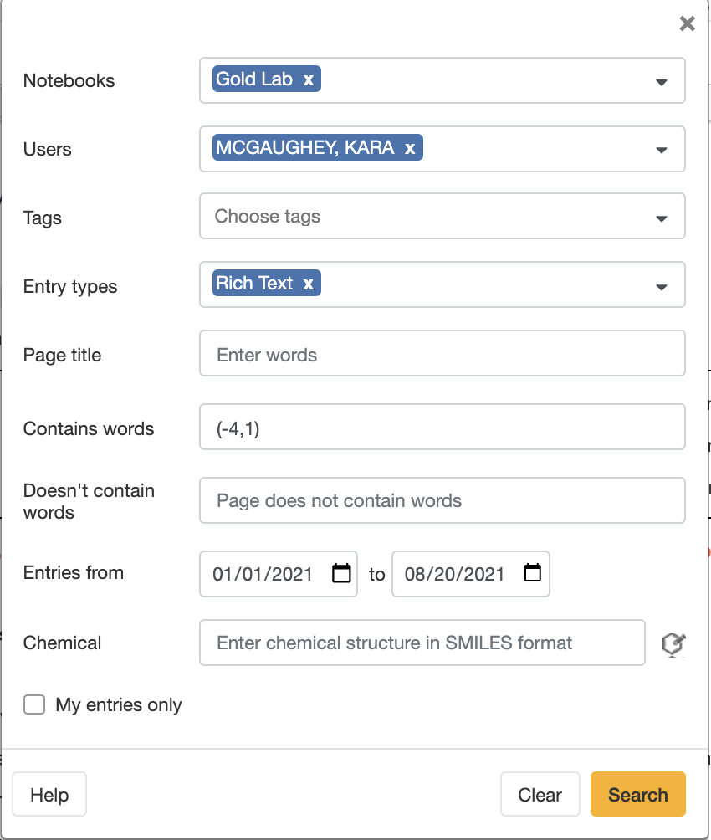
ELNs offer enhanced searchability
Using keywords or phrases, you can search entire ELNs.
You can restrict and refine your search to entries created by certain users, entries of a specific type, and/or entries within a specific date range.
Notes:
Another huge plus to ELNs is the enhanced searchability.
With an ELN like LA, you can search entire notebooks with keywords or phrases
For example, using my own notebook, I searched (-4,1), which is a gridhole location where I was recording a few months ago. Being able to quickly tabulate the number of times I’ve recorded in a particular gridhole is super useful. It gives me a sense of how often I’ve tracked through the area with my electrode and, in turn, how healthy I might expect the cells there to be.
You can even further restrict and refine your search – filtering the entry types or date ranges to search through.

Slide 7
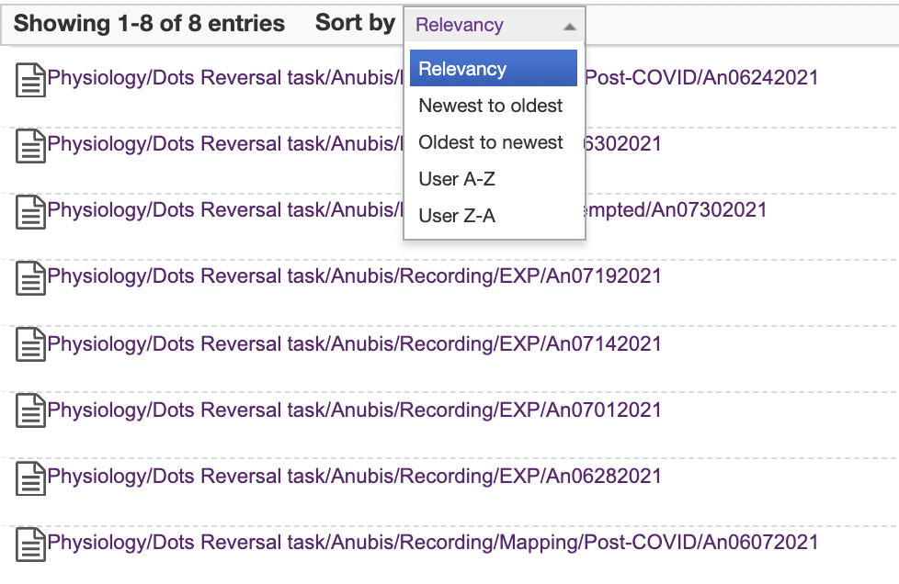
ELNs offer enhanced searchability
ELNs are searchable, so finding things is easier and faster.
Notes:
We can see here that the search returned 8 results
And – since I’ve adopted a consistent naming scheme for my experiments -- from looking at the file paths, I can get even more information --- like the date and type of each experiment that matched the keyword.
This searchability makes finding things much easier and faster than in a traditional notebook where I would have had to flip by hand through about 2 months of data.
So, to put it simply: ELNs are searchable, which makes finding things is both easier and faster.

Slide 8
LabArchives is secure and stored in multiple locations
LabArchives ELN data are securely stored on serves off-site
Password protected (aka requires PennKey & two-factor authentication)
Data is encrypted in transit and on servers
Security measures are routinely tested and upgraded
LabArchives ELN data are stored in multiple locations
Primary on East Coast, secondary on West Cost
Backups stored in multiple locations off-site to protect against disasters (fires, flooding, etc.)
Notes:
LabArchives is also really secure, and data are stored on servers off-site in multiple locations.
Everything on LA is password protected -- in other words, it requires that you sign in with your PennKey and password and then two-factor authenticate.
Any and all LA-affiliated data is encrypted both in transit and on the servers themselves.
The security measures are routinely tested and upgraded.
Moreover, LA ELN data are stored in multiple locations -- with storage on both coasts *and* backups stored in multiple additional locations to protect against disasters.

Slide 9
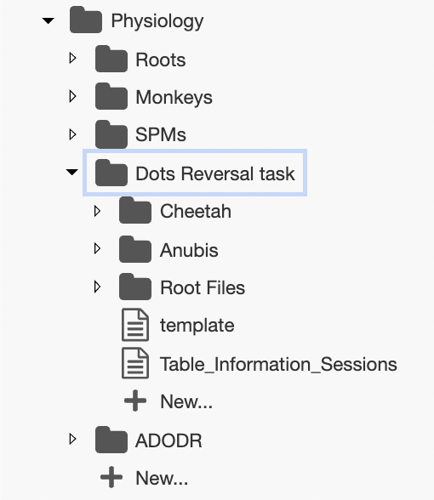
LabArchives and ELNs allow for flexible organization
Notebook
Folder
Subfolder
Page/entry
Notes:
Another benefit of ELNs is the flexibility with which you can organize your data.
Using an example again from my own lab notebook, you can see the different possible elements.
You can have more than one notebook.
And within each notebook you can create folders, subfolders and then individual pages within the folders to organize information hierarchically

Slide 10
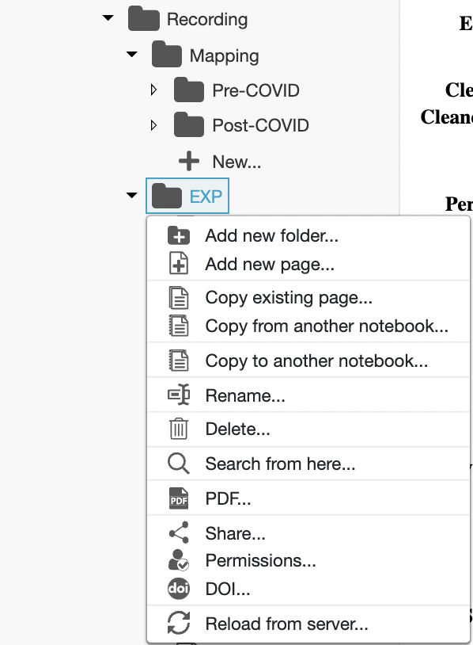
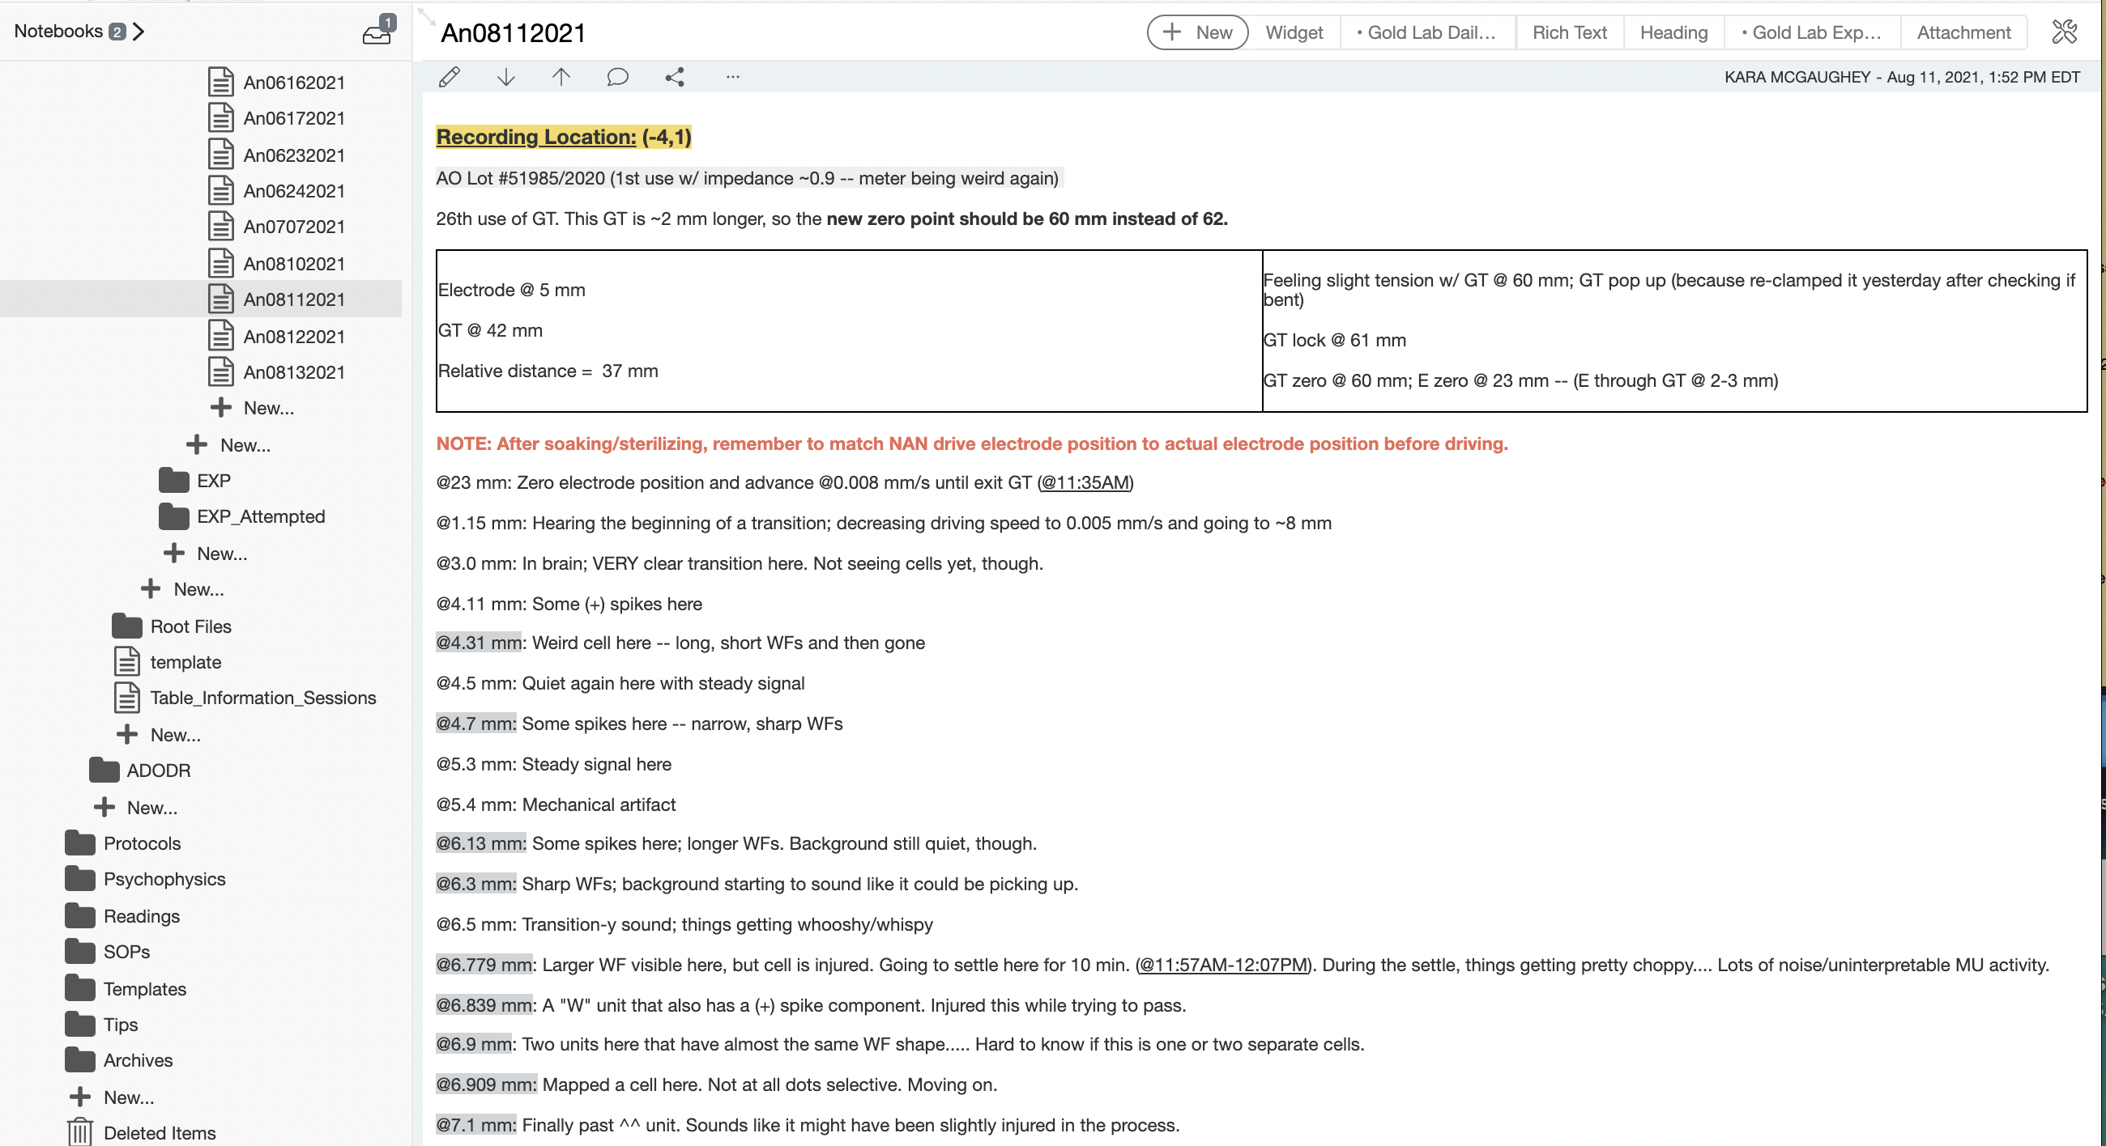
Quickly copy, download, or share entries, folders, and entire notebooks
Notes:
It’s also incredibly easy to copy, download, or share entries, folders, and entire notebooks. You can even link sections of your notebook together.
These functionalities save you tons of time.
For example, since I’m often running the same experiment over and over, I’ll add a new page to my ELN by copying an existing page. That way, I only have to change a few measurements and parameters and I don’t need to copy down things – like the lot number of my electrodes – over and over.
As another example, in an entry describing your current experiment, you might create a link to the appropriate protocol
In this way, you don’t have to retype all of the relevant steps you’ve completed, but only have to note where you may have deviated from what’s already been outlined elsewhere and linked.
Steve talked in the lab notebook presentation about the importance of including the protocol, and there isn’t an easier way to do that than this.

Slide 11
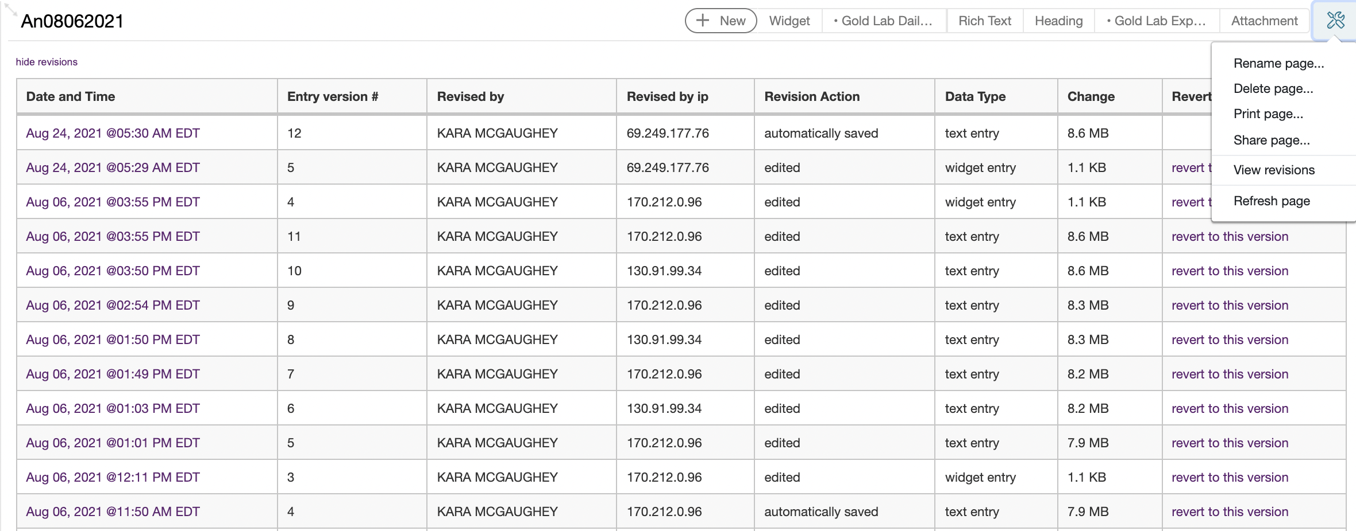
LabArchives tracks changes and revisions
Tracking changes allows you correct mistakes and protect the integrity of your research.
Notes:
And last but not least, not only can ELNs be changed easily, but these changes are also always tracked and can be reviewed later on.
This can become particularly important if there are ever questions about things like patentability or research misconduct.
So in any entry within LabArchives, you can click “View revisions” and it will give you a list of every change that’s been made to the page.
This list includes:
The time and date that the change was made,
Who made the change (if you’re using a shared notebook),
And even provide a method to revert to previous versions if you made a change by mistake.
And if you click on a particular member of the list, it will show you exactly what changes were made and allow you to step through older and newer revisions if need be.
So, while it is easy to make necessary changes to an ELN, they are all tracked and reviewable, allowing you to correct mistakes and protect the integrity of your research

Slide 12
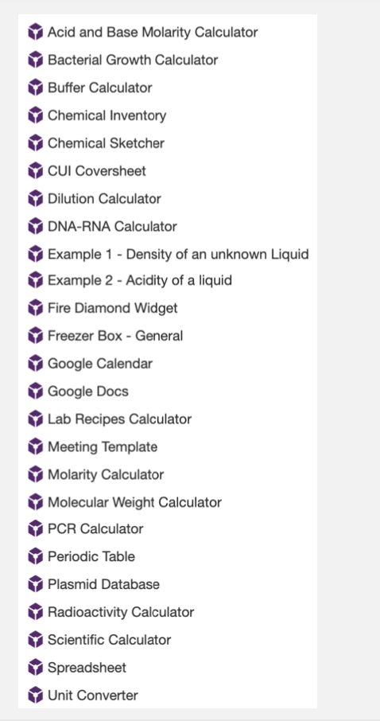
Widgets in LabArchives
LabArchives has widgets – little tools that you can embed in your notebook pages to make your experimental prep easier.
Notes:
The last thing I’ll touch on today is widgets – and how you might want to make use of them – as well as different types of LabArchives entry types for different types of data.
On the right of the screen here are a bunch of default widgets that come with LabArchives.

Slide 13
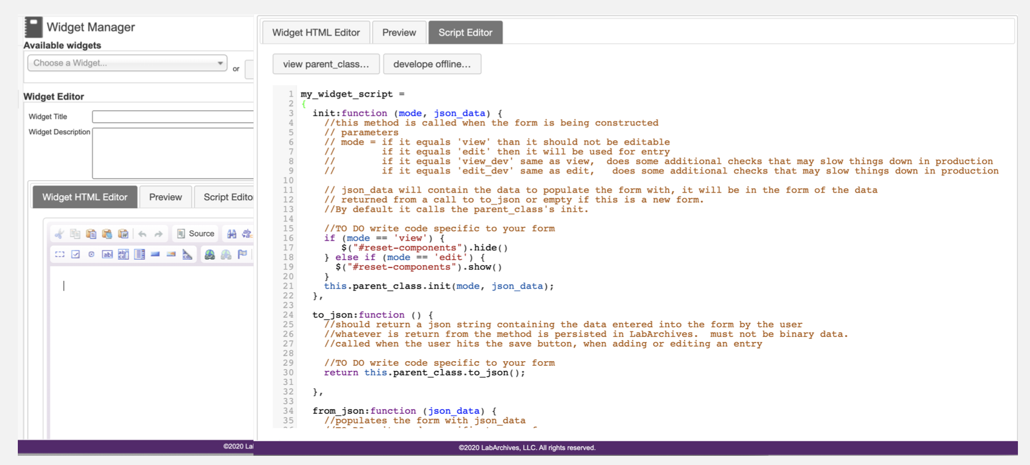
You can make your own widgets!
Notes:
But there’s absolutely nothing stopping you from making your own, and that’s what my lab has done.

Slide 14
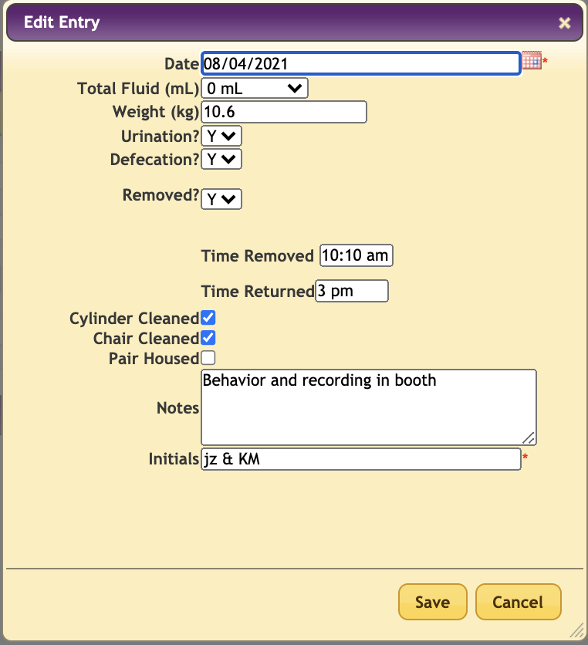
LabArchives widgets make storing your information easier
Notes:
One of the widgets that gets used every day is this Animal husbandry widget that helps us keep track of the weight, urination, defecation, housing, and chamber cleaning of each non-human primate.
There’s also a section of the widget for entering the time an animal was removed from the animal room for an experiment as well as the time they were returned.
As this information is saved, it populates a massive --- and completely searchable or filterable – table.

Slide 15
LabArchives widgets make tracking your experiments easier
Notes:
Another widget I see on a daily basis is this one.
It store a bit more specific information about the timing of experiments than the animal husbandry widget. In addition, there are places to note the location of a recording on a particular day, the behavioral task that was run, which rig was used, and any other notes that seem important to include.

Slide 16
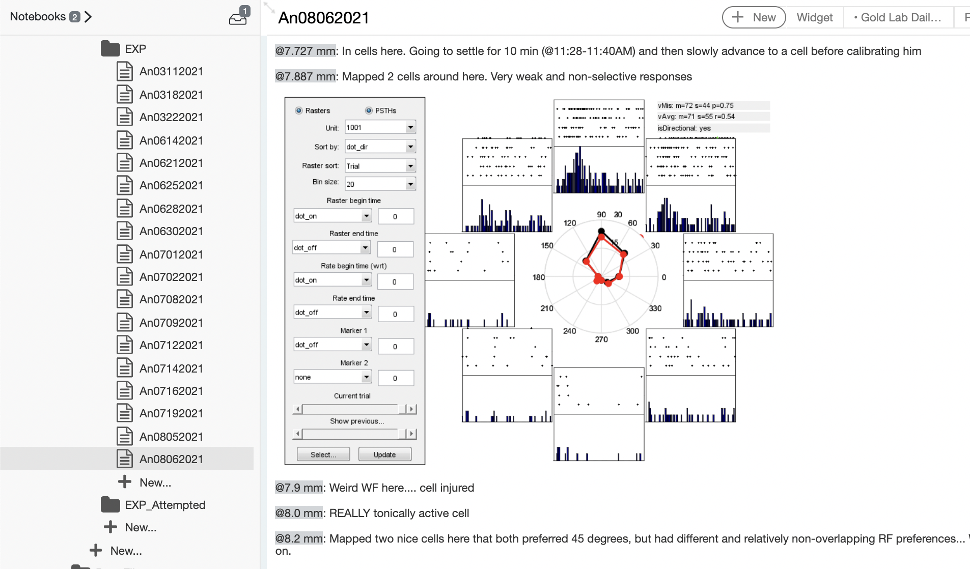
LabArchives widgets make tracking your experiments easier
Notes:
While widgets are wonderful, the other data entry types are also incredibly useful.
I’m a huge fan of plain and simple, so I often just use a massive rich textbox.
I like that I can store my notes in a very vertical format – it makes the most sense to me given that the notes reflect information about what I’m finding at different electrode depths. I also like that I can easily highlight text in different colors and use colors to convey information. For example, I highlight in grey the electrode position or depth where I’m in grey matter, and leave the background while when I’m in white matter.
I also love how easy it is to embed images.
This image is a polar plot I made in MATLAB during a recording session that conveys important information about the directional tuning properties of the cell I had isolated.
During any given recording session, I’m constantly making judgements these neural preferences, so it’s nice to be able to directly embed the evidence I used to make these decisions should I ever need to go back and re-think or if I start second guessing and need to reconvince myself that I made the right call.
In the spirit of airing our notebook mistakes… At first, I definitely used to try to draw the shapes of these plots into my paper notebook, which was obviously both less accurate and less effective.

Slide 17
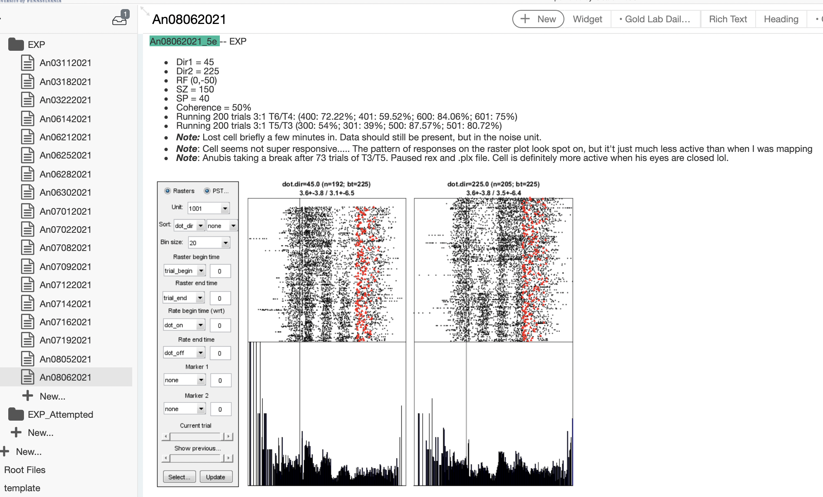
LabArchives widgets make tracking your experiments easier
Notes:
Here’s another example of how I like to use color – highlighting in this teal color each time I’m taking notes on a file I’ve uploaded to Box. The file name here matches the filename on Box and – if I wanted – I’d be able to link the file right here in my notebook.
Underneath each file name, I make a bulleted list of all the parameters I used or changed for that experiment as well as any relevant notes. Some excellent and somewhat sad documentation going on here as I wrote “Cell actually seems more active when his eyes are closed lol”
Again, it’s simplistic, but it’s incredibly efficient and effective.

Slide 18
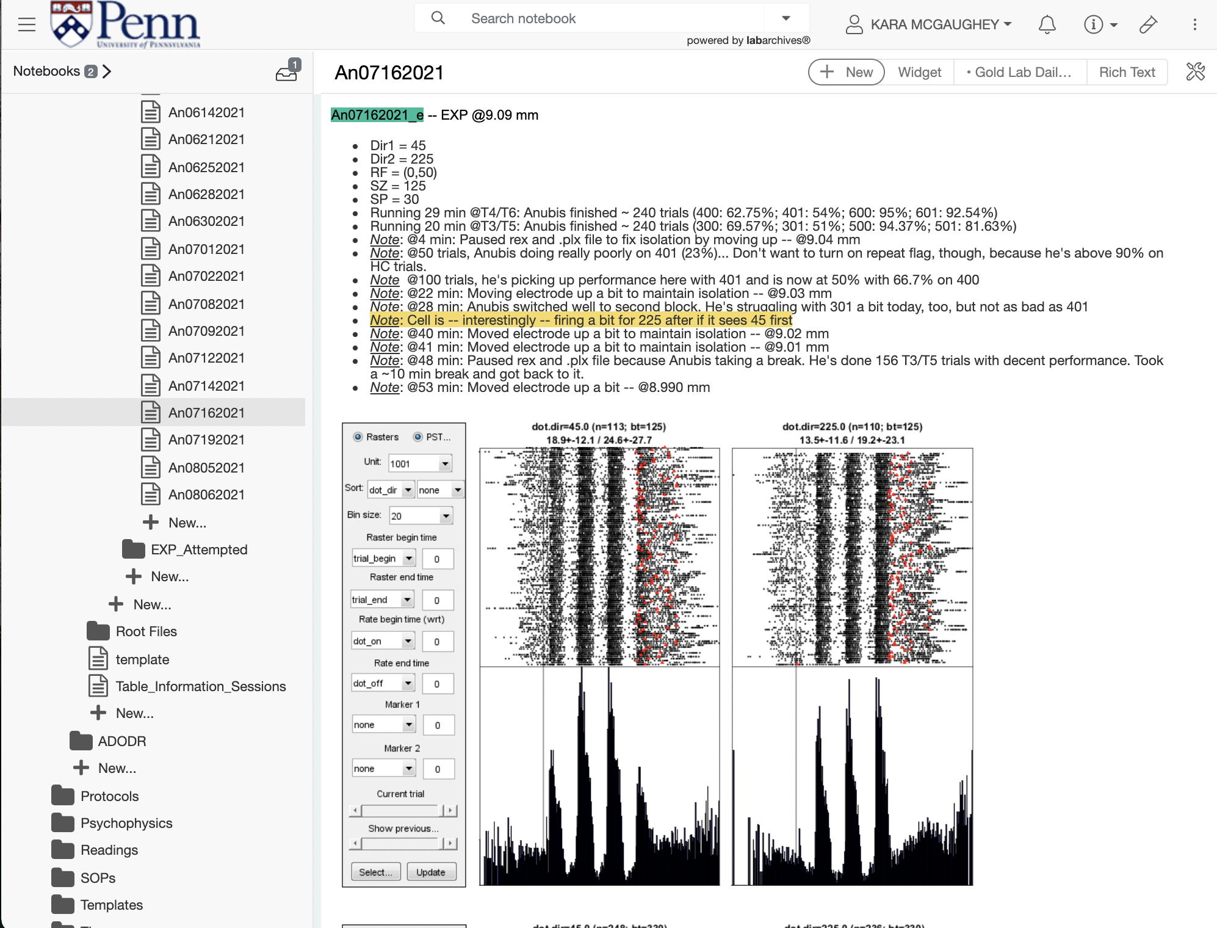
Notes:
And it’s largely that efficiency and effectiveness that convinced me – a true paper notebook lover – to give LabArchives a try. And after that, I just never went back.

Slide 19
Interested in trying out LabArchives?
Attend the LabArchives breakout session!
MEETING ID: 964 1259 9295
PASSCODE: 808862

